Slide 1

Total Quality Management
What is the meaning of quality?
  The totality of features and characteristics of a product or service that bear on its ability to satisfy stated or implied needs.
What is needed for TQM?
  The cooperation of all levels within the organization.

Slide 2
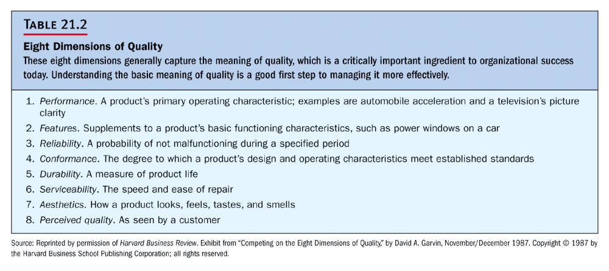

Slide 3
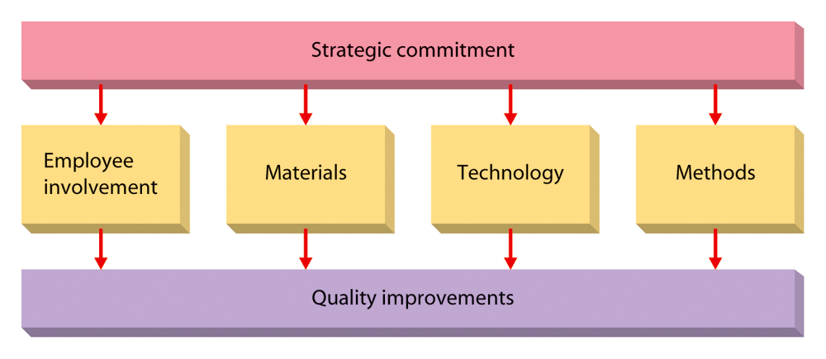
Elements for TQM

Slide 4
TQM Tools and Techniques
Value-added analysis—what is it?
  A comprehensive evaluation of:
    All work activities.
    Materials flow.
    Paperwork to determine the value added for customers.
    What Is Benchmarking
The process of learning how other firms do things in an exceptionally high quality manner.
What does benchmarking enable firms to do?
  To stay abreast of improvements and changes its competitors are using.

Slide 5
More TQM Techniques:
Speed:
  The time needed to get something accomplished; it can be emphasized in any area, including developing, making, and distributing products or services.
ISO 9000:
  A set of quality standards created by International Organization for Standards.
SQC:
  Statistical Quality Control, a set of specific statistical techniques used to monitor quality.

Slide 6
A View of JIT: Just-In-Time
Supplier
Transporting
Transformation
Process
Completed
for
Customer

